Slide 1

Synthesis Hacks

Slide 2

Event Schedule
Synthesis Hacks 2026
09:00 AM
Check-in & Breakfast
01:30 PM
Lunch Break
Doors open; breakfast served until 11:00 AM
Available until 02:30 PM
09:30 AM
Team Mixer
03:00 PM
Hacking Deadline
10:15 AM
Opening Presentation
03:30 PM
Judging Session
10:30 AM
Hacking Officially Begins
05:30 PM
Winners Announced
06:00 PM
Event Ends
Synthesis Hacks

Slide 3
Prize Tracks
Social or Game
Create a technical app or game to help users understand networking concepts like interactive simulators.
Network Application
Develop an application that involves hosting and serving multiple users across the internet.
Security
Design and implement Access Control Lists (ACLs) to effectively secure and filter network traffic.
Programmability & Automation
Leverage Python with Netmiko through Emulated Cisco devices on Gns3
Network Analysis
Build a tool or dashboard that ingests packet captures to analyze traffic behavior and security threats.
Synthesis Hacks

Slide 4
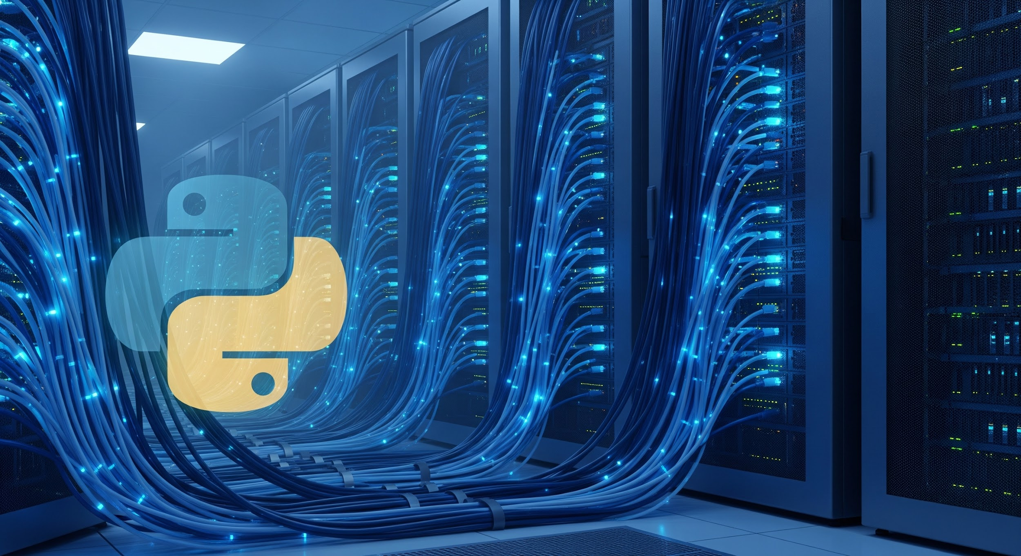


Technical Deep Dives & Guidance
Hosted immediately following the Opening Ceremony
Track Leader: Rachit Verma
Programmability & Automation
Deep dive into Python scripting and GNS3 workflows.
Track Leader: Richard Graziani
Security
Mastering ACLs and securing enterprise network traffic.
Track Leader: Nathan Wagner
Network Analysis
Advanced packet capture analysis and dashboarding.
These sessions will help set up hackers and provide full clarity on project guidelines.
Synthesis Hacks

Slide 5

Guest Speak: Professor Richard Graziani

Slide 6





THE WAIT IS OVER
GET HACKING!
START NOW
Synthesis Hacks 2026

